Slide 1
Shell Bootcamp 2024 3 Reflections for Week 1
G Joshita Reddy
Date : 30-Aug-2024

Slide 2

About Me
Expand your horizons, don’t stay stuck in your comfort zone

Slide 3

My learnings from this week!

Slide 4
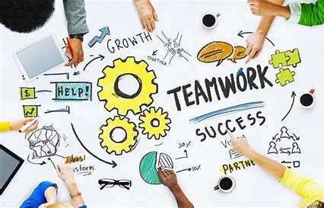
Learning 1 | My takeaways
Teamwork is dreamwork
We should help each other win rather than just winning as cost of some other person’s loss
In energy sector, like every other sector, it is important to work and function as a team for the success of project and our own personal growth.
[Add a graphic that provides evidence of what you learned]

Slide 5
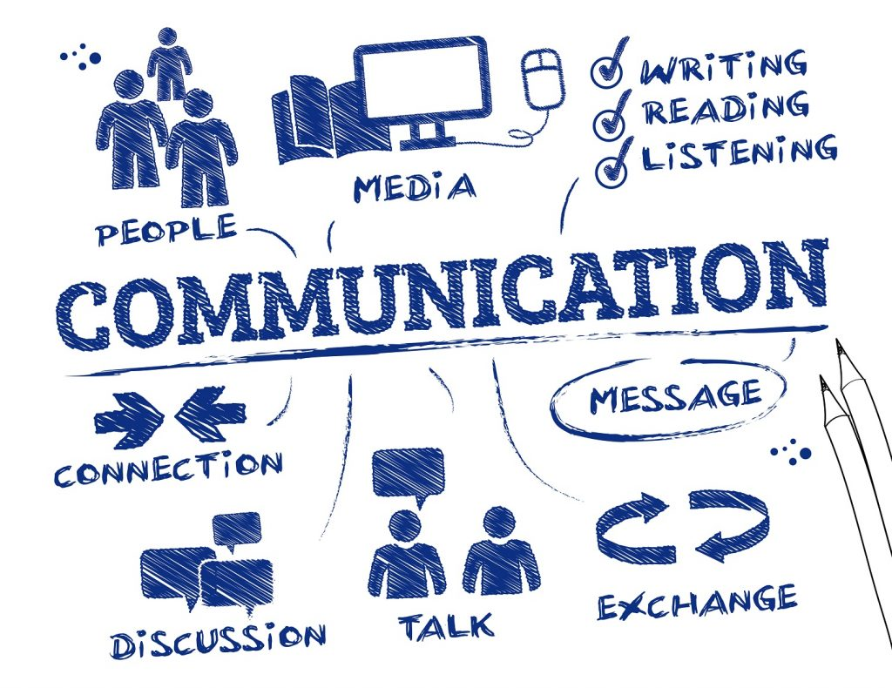
Learning 2 | My takeaways
Communication is the Key
Being able to communicate means to actively listen to other person & actively speak our opinion
In a project communicating with our team, our colleagues and stakeholders plays an important role.

Slide 6
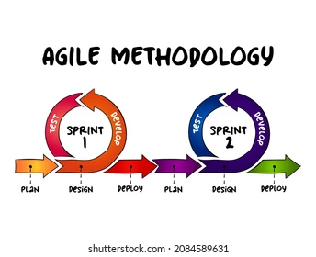
Learning 3 | My takeaways
BA & Agile
Learnt various terms used in Agile methodology such as user stories, epics, PI planning, business requirements etc.
It is important to understand these terms as these are frequently used and helps us navigate better in workspace.
[Add a graphic that provides evidence of what you learned]

Slide 7

Relevance of learnings for my organization

Slide 8
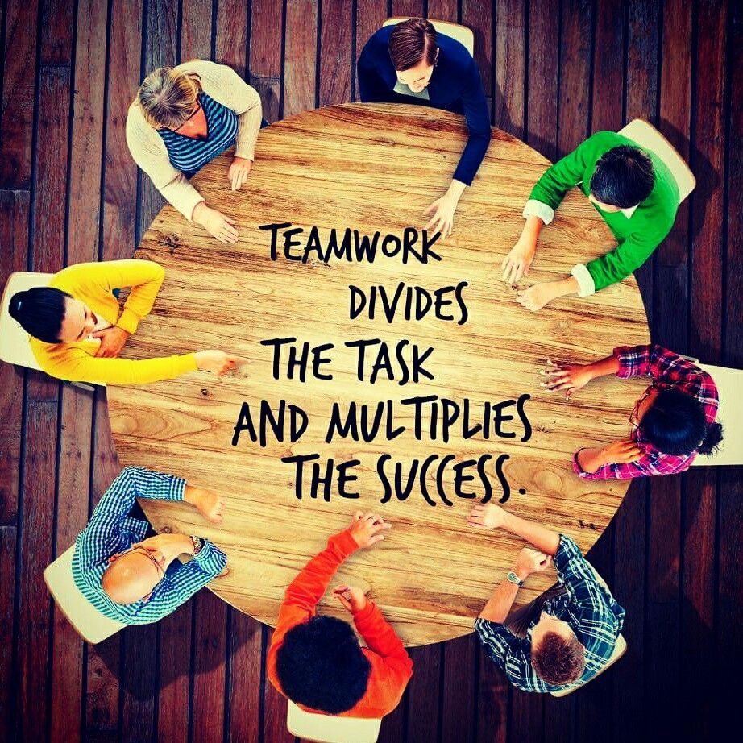
Learning 1 | Relevance for Shell
Shell has its core values as honesty, integrity & respect for all people, and teamwork is one of the ways Shell upholds these integral values.
If I can work well with my team, I can contribute towards more towards with the team’s goals which in turn contributes towards success of the company.
[Add a graphic that provides view of how Shell implements this learning]

Slide 9

Learning 2 | Relevance for Shell
Shell has a good networking culture, where people can know each other through various platforms such as GTKYs.
It is important to communicate well in any workspace so that our opinion is heard, and it adds value to any discussion among our team or colleagues in Shell.
[Add a graphic that provides view of how Shell implements this learning]

Slide 10
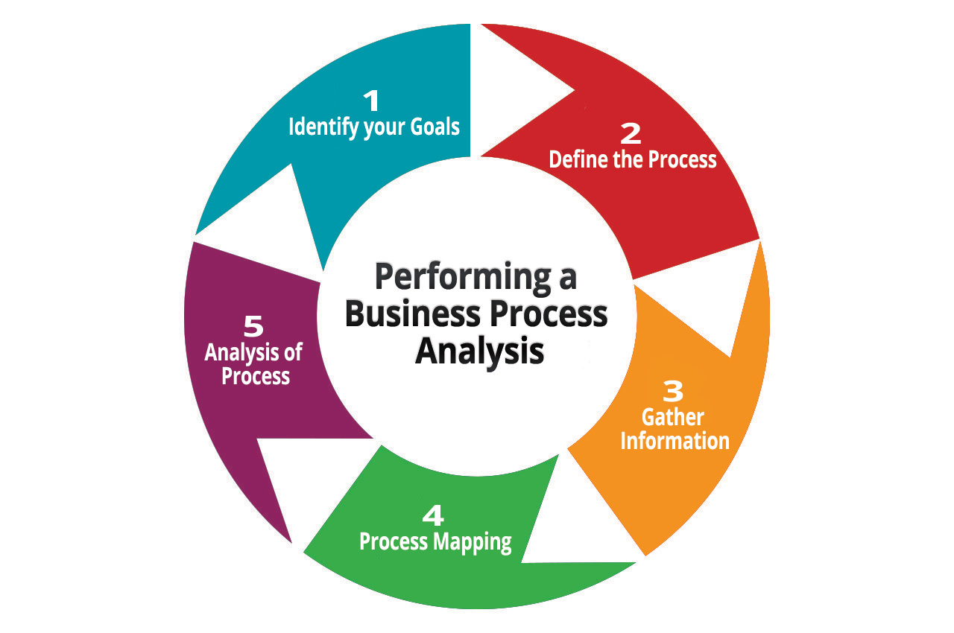
Learning 3 | Relevance for Shell
Business analysis and Agile are used in technical projects and the tool, Azure DevOps, helps plan, track, and discuss work across your teams.
Business analysis & Agile helps us have a higher-level understanding of the project and what role we play in it.
[Add a graphic that provides view of how Shell implements this learning]

Slide 11

Challenges in implementing learning

Slide 12

Challenge faced while implementing Learning 1
Initially, its is difficult to work with other people as we don’t know them, but as we get to know them a group of people becomes a team and succeeds.
[Add a graphic that provides evidence of what you did to overcome this challenge]

Slide 13

Challenge faced while implementing Learning 2
It is daunting to speak our opinion our loud but knowing that the smallest voice can make a difference helps to speak out.
[Add a graphic that provides evidence of what you did to overcome this challenge]

Slide 14
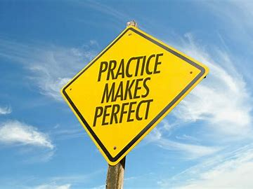
Challenge faced while implementing Learning 3
Introduction to Azure DevOps was a little bit confusing as it was new to us but as we explored more, it became easier to understand and work with.
[Add a graphic that provides evidence of what you did to overcome this challenge]

Slide 15

Action Plan

Slide 16
My Action Plan for this Week
Actions
Timeline
Status
Remembering the new terminologies I have learnt.
Research more about new concepts I have been introduced to.
By this weekend I hope to work on my plans research more on the terms I have learnt. expanding my knowledge.
Delved deep into some concepts and some are still left to introspect.

Slide 17

Learning is also Fun!

Slide 18

Learning is also Fun!
Various group discussion and roleplays on stakeholders made the concepts easy to understand
It was extremely fun to see people standing in other person’s shoes/heels and understand the much deeper lesson on empathy behind it.
[Add a graphic or a picture of how you/your team enjoyed the new learning]

Slide 19

Summary
Learnt about etiquette in workplace, how teamwork is the key & how communication is important.
Explored various case studies to understand the importance of stakeholders.
Understood various terminologies related to business analysis & agile through hands-on sessions
It is important to understand basic roles & responsibilities of different members in a project before delving deep into each roles.

Slide 20
Thank You

